Slide 1
Guided Capstone Project Report
Steve Li
Springboard

Slide 2
Problem identification
1
Context
4
Constraints within solution space
Big Mountain Resort’s pricing strategy has been to charge a premium ticket price without getting into the data that supports the decision. Company wants to implement a more data-driven business strategy to understand the facilities and impact of business decision to a premium ticket price and guide their future investment and cost cutting activities.
There is no data of cost of living in every state, which is one of the factors that determines ticket price.
The current investment of an additional chair lift is a done deal.
2
Criteria for success
5
Stakeholders to provide key insight
To build a pricing model on adjusting ticket price to achieve 5% return on investment at the end of this season.
Jimmy Blackburn – Director of Operations
Alesha Eisen – Database Manager
3
Scope of solution space
6
Key data sources
Gather, clean the data, and construct a pricing model that predict ticket price based on resort characteristics, such as Terrainparks, runs/skiable terrain_ac, nightskiing_ac, fastlift, quad_triplelift, etc.
Data that contains information from 330 resorts in the US from SQL database or a S3 bucket

Slide 3
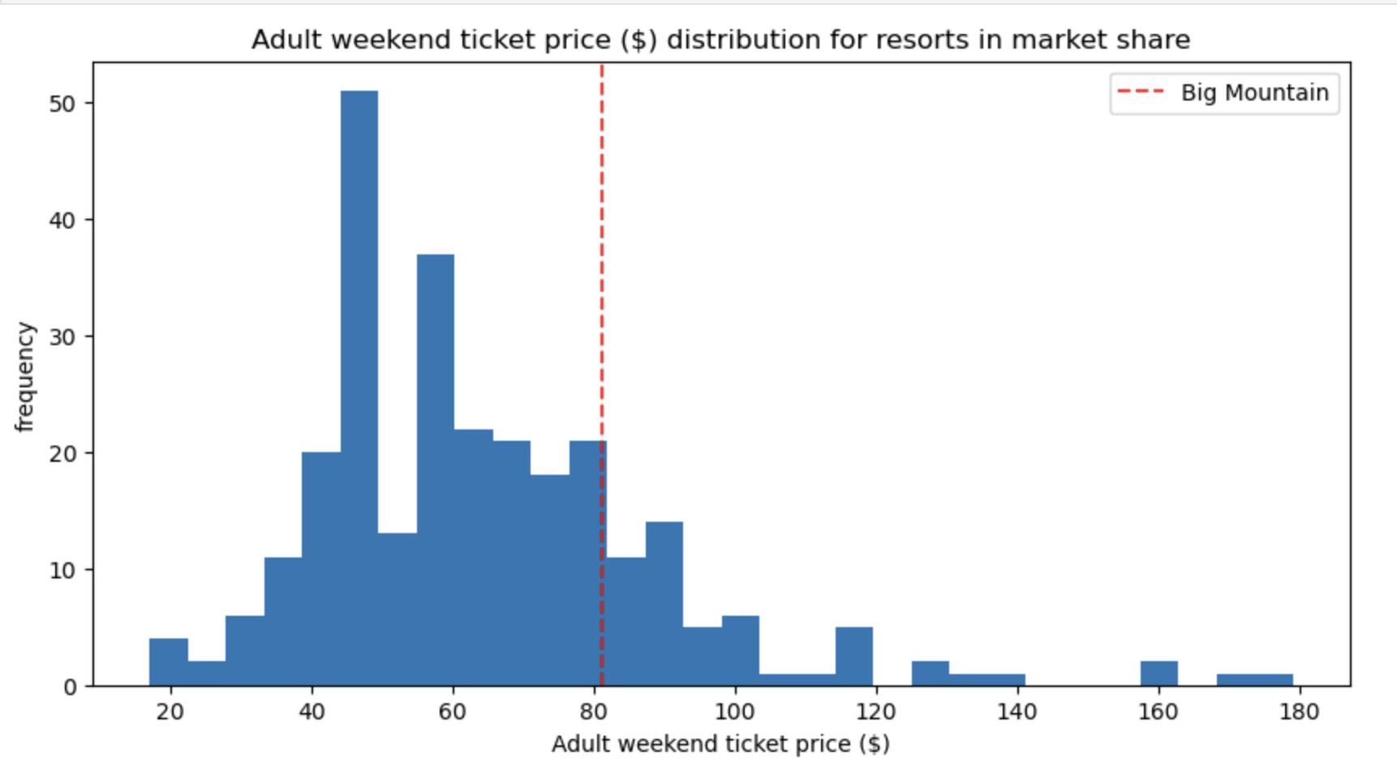
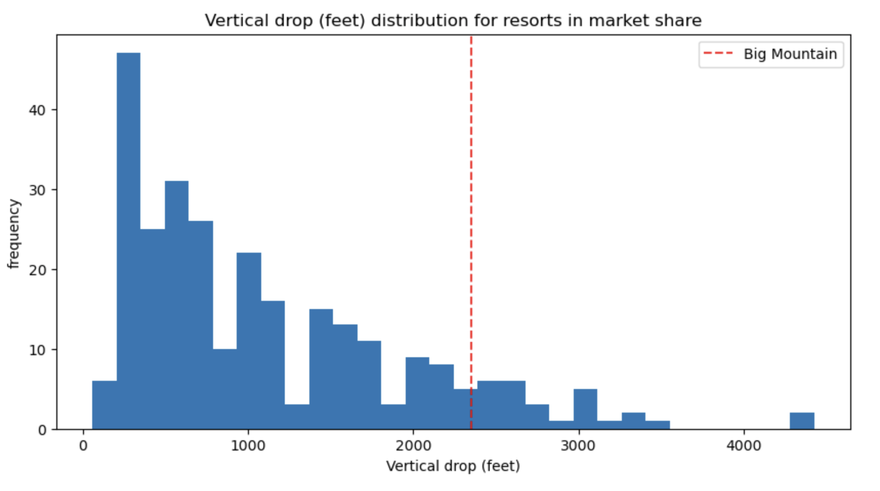
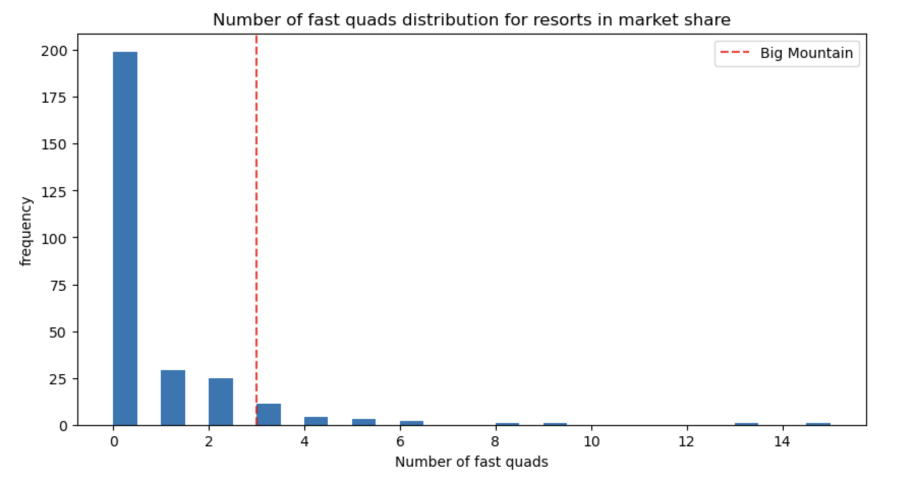
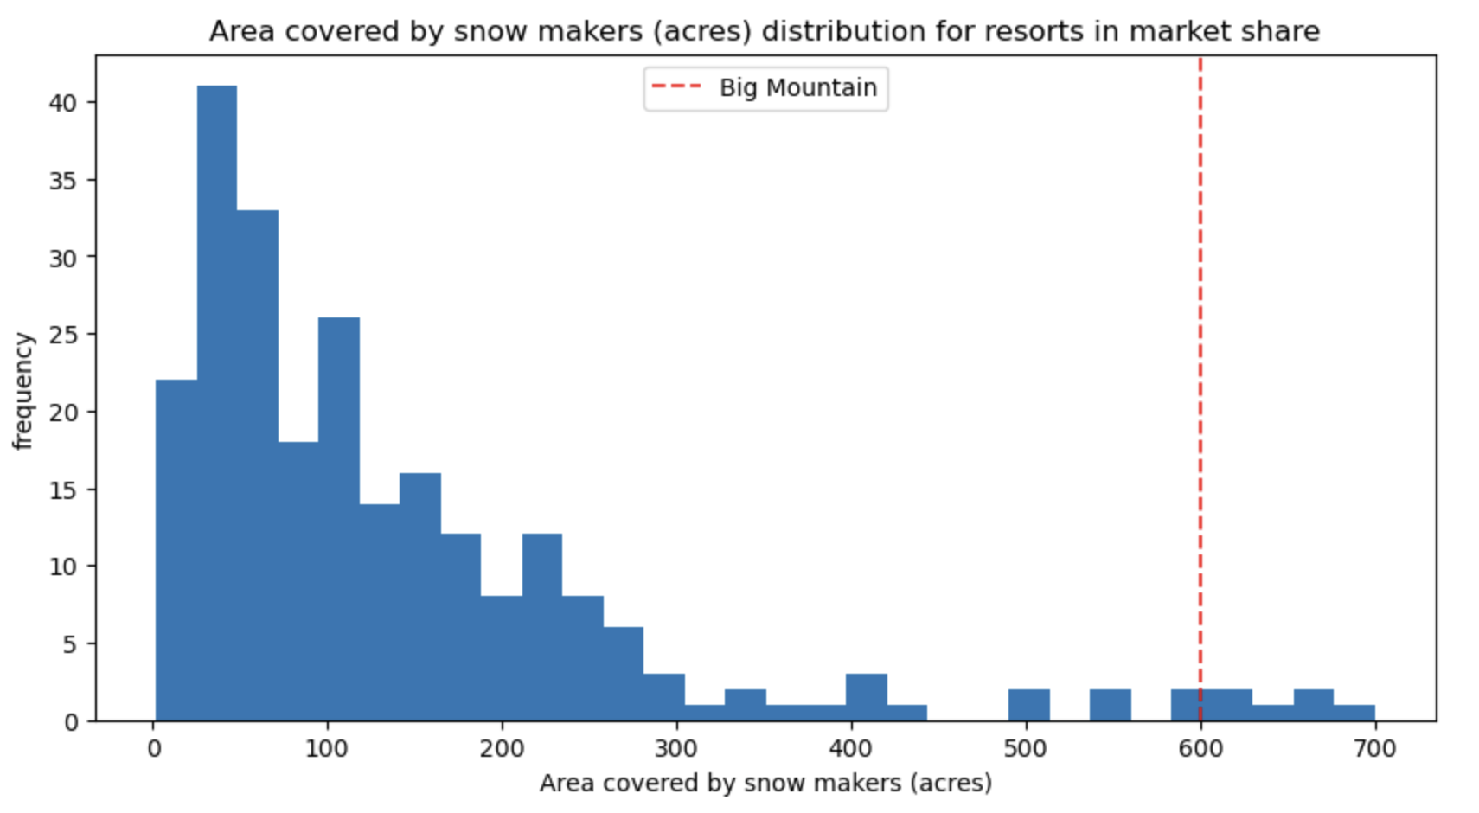
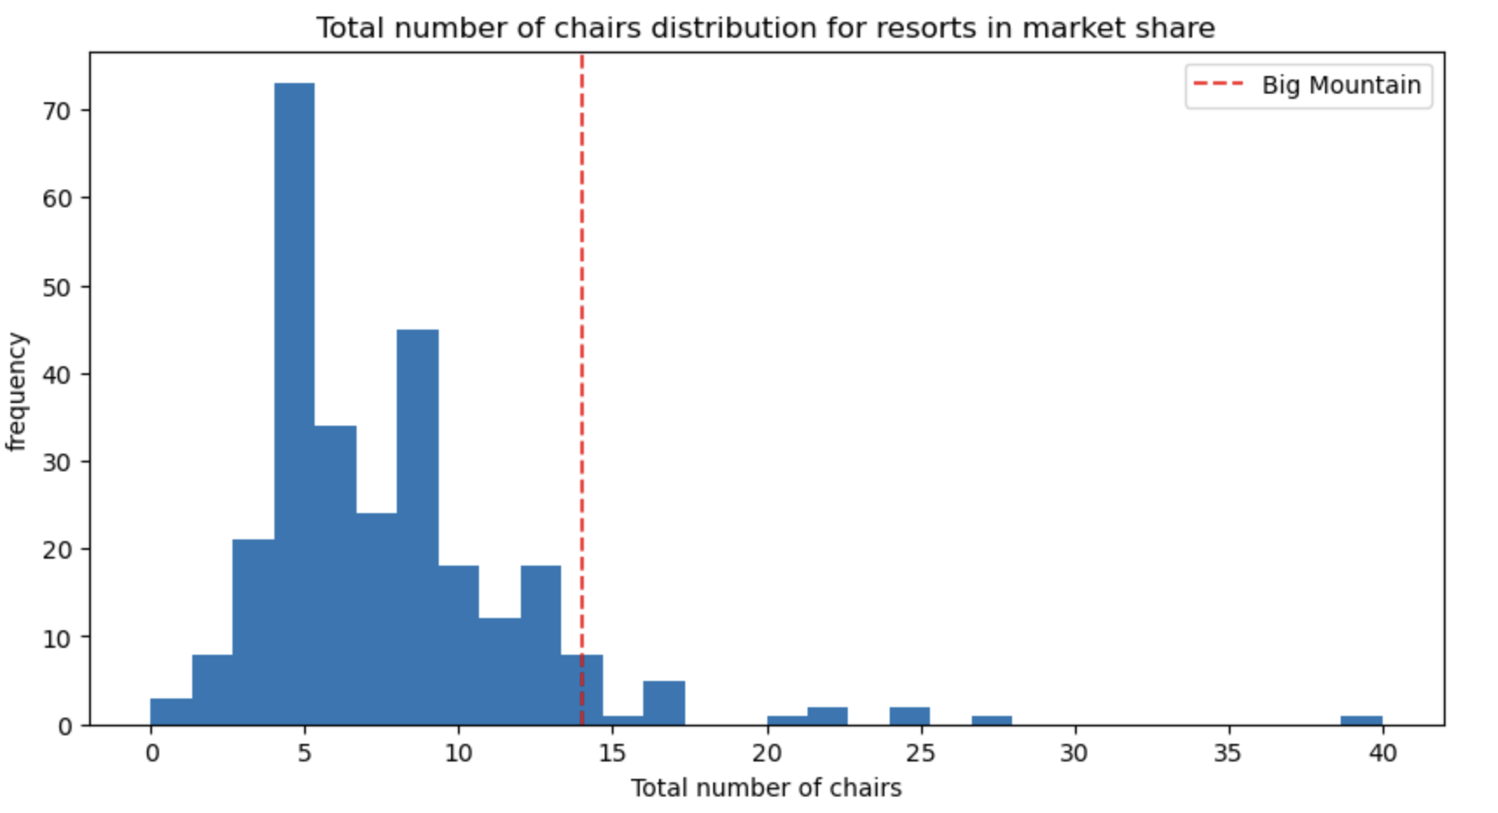
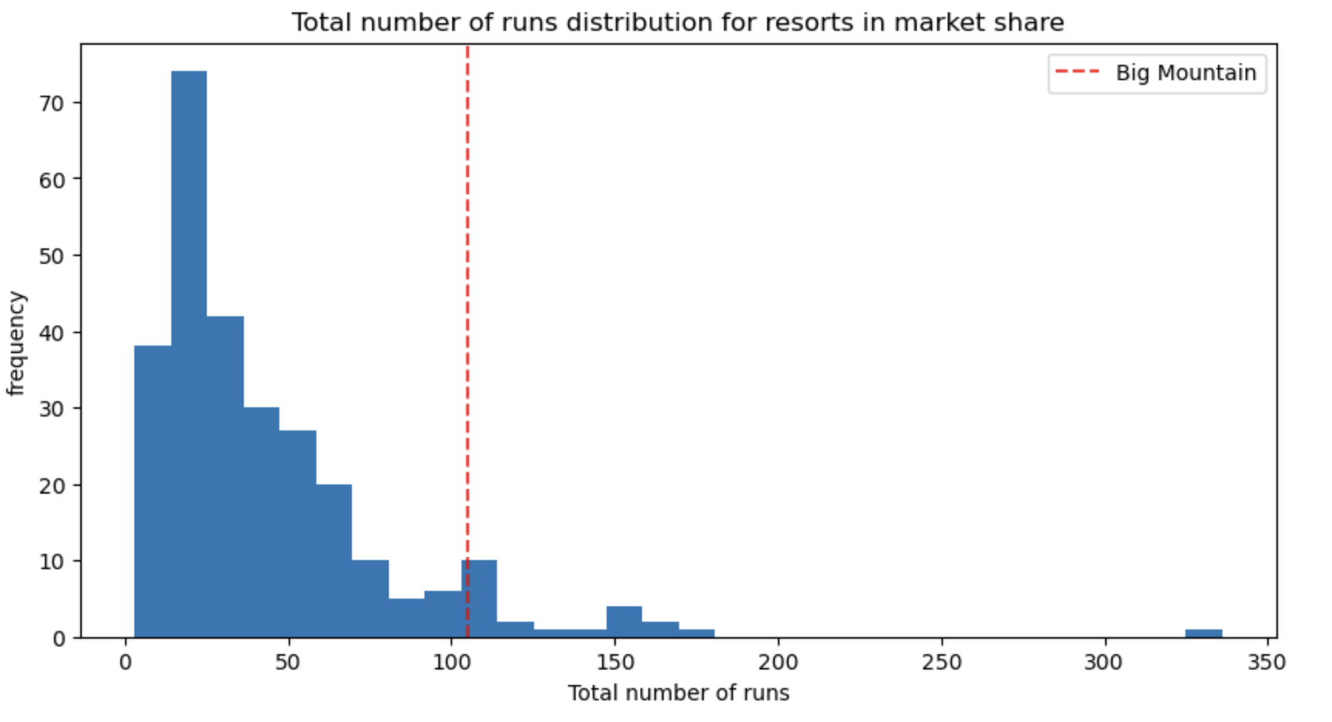
Recommendation and key findings
Room for weekend adult price increase is about 10% (from $82 to $89)
Big Mountain Resort has market leading facilities
Top four features that affect ticket price - vertical drop, snow making area, fast quads, runs

Slide 4
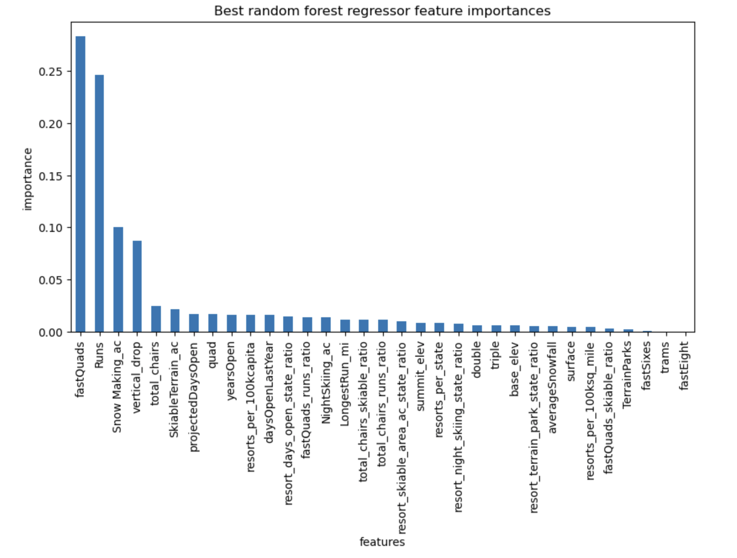
Key finding for scenarios
Scenario 1 – close up to 10 of the least used runs
Finding – Closing one run makes no difference in ticket price and revenue. Closing 2 and 3 reduces support for ticket price and revenue. Close down 3 runs shows similar impact as closing down 4 or 5 runs. Increasing the closure down to 6 leads to a large drop.
Scenario 2 – add a run, increase the vertical drop by 150 feet, and installing an additional chair lift
Finding – provide support for ticket price increase by $1.57 and expected to @2750000 over the season
Scenario 3 – add 2 acres of snow making after scenario 2
Finding – make no difference
Scenario 4 – increase the longest run by 0.2 miles and add 4 acres of snow making capability
Finding – no difference

Slide 5
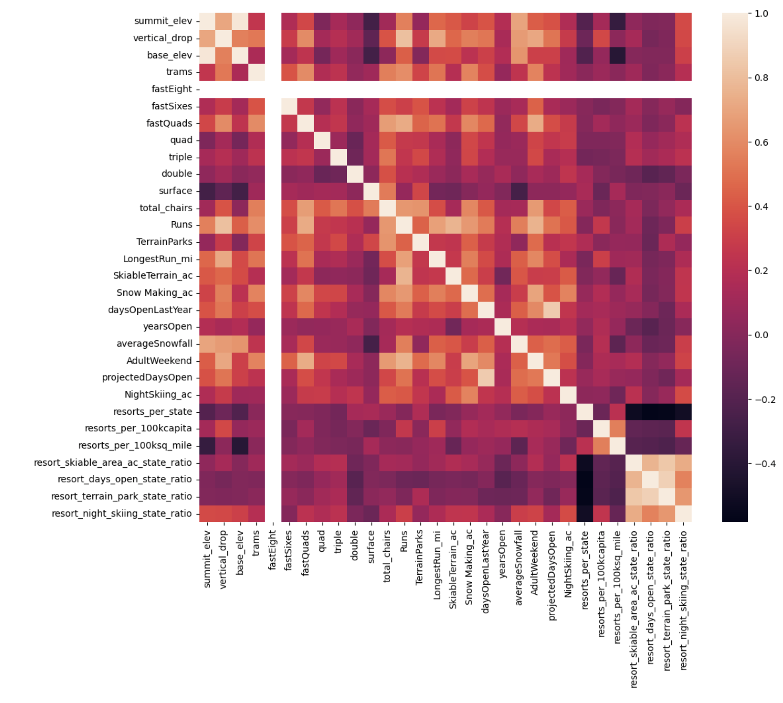
Feature correlation from heatmap
Heatmap() from seaborn was applied to features
Summit and base elevation are highly correlated.
Ratios are negatively correlated with the number of resorts in each state
Ratio of night skiing area shows positive correlation with the number of resorts per capita
fastQuads, runs, vertical drop, and snow making_ac show correlations with adultweekend ticket price
The new feature resort_night_skiing_state_ratio correlates with ticket price

Slide 6
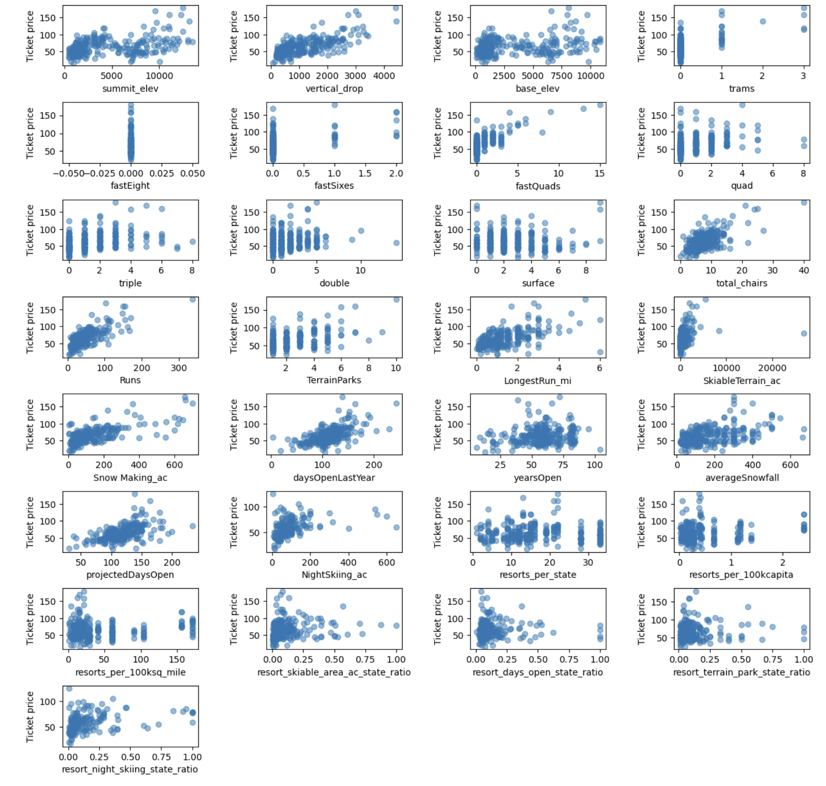
Feature correlation from scatterplot
Vertical_drop shows strong positive correlation with price
fastQuads, Runs, and total_chairs shows similar correlation

Slide 7
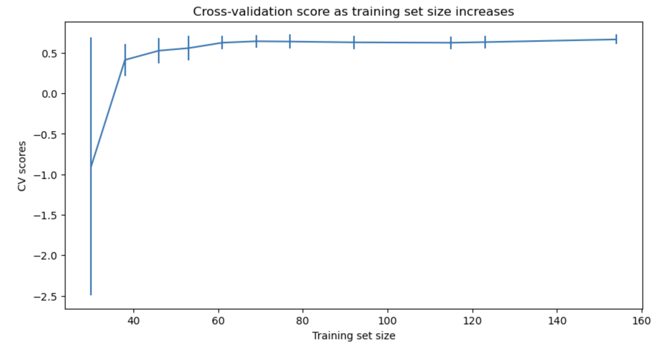
Model results
Both linear regression and random forest regression were used to construct the model; cross-validation was used to evaluate model performance; hyperparameter search using gridsearchCV was implemented to find the best parameters for each model
The random forest model has a lower cross-validation mean absolute error by almost $1. Linear regression model gives mean absolute error of 15.10 while random forest model gives mean absolute error of 9.61. Therefore, random forest model was selected.
By looking at performance change with different data set sizes, there is an initial rapid improvement in model scores but it saturates around a sample size of 40-50.

Slide 8
Summary and conclusion
Random forest regression was chosen to model pricing target for weekend adult ticket.
Big Mountain Resort has market leading facility that provides room to raise weekend ticket price by $7.
Top features that support ticket price are fastquads, runs, snow making_ac, and vertical drop.
Closing runs reduces the support for ticket price.
Adding runs, increasing vertical drop, and adding additional chair increase the support for ticket price

